Slide 1
LEADERSHIP SKILLS AND HUMAN RELATIONS MODELS AND THEORIES OF LEADERSHIP
Damodar Niraula
May, 2018

Slide 2
Leadership Styles (approaches you adopt as a leader)
Authoritarian Style | Paternalistic Style | Participative Style | Laissez-faire Style
Employees’ Power and Control
Managers’ Power and Control

Slide 3
Authoritarian/Dictatorial/Autocratic Style (Leader-centered)
Threat, fear, authority, prestige, strength of personality are the common tools to get things done from followers
Leaders often take credit for accomplishment but put the blame for failure on their subordinates
Leaders rule with unlimited authority, subordinates are humiliated and kills their initiatives
Leaders alone make decision, no flexibility allowed to subordinates
Suitable for urgency

Slide 4
B. Paternalistic/Benevolent Autocratic Style (Leader-centered)
Works as a father figure, acts as a family head
Leaders guide, protect and treat subordinates like children
Leaders take decision but deal more kindly with subordinates and allow some flexibility and creativity
Low level of trust, limited upward communication opportunity

Slide 5
C. Participative/Democratic/Consultative Style (Group-centered)
Leaders lead by persuasion (advice, influence) and examples
Subordinates are participated in decision making, their ideas and opinions are sought before setting goals
Subordinates feel encouraged, get an opportunity to demonstrate and develop their abilities
Leaders share information freely and encourage discussion, rely on rewards than punishment
Trust and two-way communication is possible

Slide 6
D. Laissez-faire/Free rein Style (Individual-centered)
Subordinates have complete freedom of choice and can do, as they like
Leaders let the group run by itself
Subordinates themselves decide, set their own goals, leaders do not intervene
Leaders encourage to operate freely with no direction unless the subordinates ask for help
May create anxiety and tension among subordinates

Slide 7
Match these
If leader says:
As long as it is done right, I’ll see that you get what you deserve.
Do what you are told, and don’t ask questions.
I don’t care what you do, as long as you keep out of my way.
There are the results we have to achieve; this is the job to be done. Let us agree together how best to do it. Let us agree on what we are to do.
Leadership styles:
Authoritarian
Paternalistic
Participative
Laissez-Faire
Answer: a:ii, b:i, c:iv, d:iii

Slide 8
Styles | Advantages | Disadvantages
Autocratic | Quick result Maintains discipline in org^{n} Chain of command is understood by all | Does not motivate members People work only by the fear of punishment One way communication, lack of ownership feeling in decisions
Paternalistic | Effective when the leader has some group consideration | Does not take advantage of initiative or ideas from the group
Participative | Feeling of involvement in decision making process develops ownership Ideas and information shared by members can be fruitful Members grow parallel with the organizational growth | Due to pervasive discussion, the group may loose focus Takes greater time for decision making Too much autonomy may result indiscipline Leaders may avoid responsibility
Laissez-faire | Group runs by itself, no close supervision is required at all Freedom and autonomy to work my increase creativity and innovation | Group lacks real direction and thus may lack focus on the issue/goal Members may avoid individual responsibility and so productivity suffers Coordination/relational problems may arise

Slide 9
Factors that determine leadership style
1. Size of the organization:
As institutions or organization grow, problems arise which may become more difficult to address at a macro or senior management level.
At the same time, as institutions and organizations grow larger and become more multifaceted, there is a propensity for decision making to be centralized.
This situation leads to limited employee participation or no participation at all. Leaders may present ideas and invite input from employees.

Slide 10
2. Degree of Interaction/Communication
An organization may adopt open or close system for its operation.
An open system demands more interaction/open communication between members.
A close system is all about taking decision by a single person, employees are not allowed for participation.

Slide 11
3. Personality of members
Followers personality attribute determines the leadership style.
If followers tend to take participation, capable of taking decision, and mature enough for taking responsibility for the outcome, leadership style may demand more flexibility and vice versa.

Slide 12
4. Level of decision making
Level of decision can be:
Level i: leader makes the decision alone and announces the decision
Level ii: leader gathers input from individuals and makes decision
Level iii: leader gathers input from team and makes the decision
Level iv: consensus building/leader is a part of team and has one vote/group takes decision with the agreement of all
Level v: consensus and delegation with criteria/leader delegates decision making to team with clear constraints/don’t be part of decision making discussion
(Leadership in centralized organizations is directive and vice versa)

Slide 13
Theories of Leadership
The Naturalistic Theories of Leadership
(the idea behind it is leaders are born, not made)

Slide 14
The great-man theory (GMT)
Assumptions:
The leaders are born and not made and posses certain traits which were inherited
Great leaders can arise when there is a great need.

Slide 15
Concepts:
Leaders are normally man
The term GMT has been originally associated with the nineteenth-century Scottish historian Thomas Carlyle
In his book “On Heroes, Hero-Worship, and The Heroic in History”, he declared, “The history of the world is but the biography of great men”.
He argued that effective leaders are those gifted with/the package of divine inspiration/godly motivation and the right characteristics/personality.

Slide 16
Critics:
Not all people who possess the so-called natural leadership qualities actually become great leaders
Leadership is the function of social need/influence rather intrinsic ability
Leaders are the products of the atmosphere and society they worked and lived in. In other words, society shapes great men as oppose to them shaping society
It has gender biasness

Slide 17
The Trait Theory
Assumption:
Leaders are born, not made
Leadership success is largely a matter of personality; a function of specific traits
They differ greatly from their follower
Traits remain unchanged across time

Slide 18
Concept:
Advocates that certain personality traits make leaders good
Traits are largely the function of heredity, but to some extent it can be acquired as well (based on experience or learning)
Personality traits that make a leader effective can be; intelligence, self-confidence, task-relevant knowledge, energy, initiative, self-assurance, decisiveness, maturity, agreeableness etc
Identification, understand, realization and/or development of such traits in leaders is critical (s/he succeeded who do)

Slide 19
Critics:
The list of personality traits is long and exhaustive
The traits of a successful leader keep changing (contextual)
There is no universal list of traits to be a successful leader
Leaders can not be extremely different from their followers
It is difficult to define and measure traits

Slide 20
B. The Functional/Behavioral Theories of Leadership
(the idea behind it is what leaders actually do)

Slide 21
Assumptions:
Effective leadership is the result of effective role behavior.
The leadership effectiveness is determined in terms of how leaders delegate their tasks, how they communicate with and motivate their followers.
The behavior of effective leaders would be different from the behaviors of less effective leaders, and
The behavior of effective leader would be the same across all situations.

Slide 22
The Ohio State Studies
Dimensions of leadership behavior:
Consideration: The extent to which a leader demonstrates trust of subordinates, respects for their ideas, and considers their feelings (the idea is to foster effective relationships).
Initiating Structure: The extent to which leader defines and structures his/her own role and those of subordinates towards goal attainment/task accomplishment

Slide 23
Findings:
Higher initial structure behavior results in higher employee performance, but lower level of their satisfaction
Higher consideration behavior results in lower employee performance, but has fewer absences from work
Thus, high-structure and high-consideration (a high-high) tends to achieve subordinates performance and higher level of satisfaction

Slide 24
The Michigan Studies
Patterns of leadership behavior:
Job-centered leader behavior: Concern is on efficiency and task performance/efficient completion of task. Required behaviors are; treat employees technically, close supervision, emphasis is on technical aspects of job, focus is on work standard
Employee-centered leader behavior: Concern is on building effective work groups. Required behaviors are; treat follower/members humanly, take consideration of their well being, and involve them in goal setting

Slide 25
Findings:
These two leadership behaviors are the two extreme points
Any given leader could either be job-centered or employee-centered, can not be both at the same time
Employee-centered leaders are associated with higher productivity and job satisfaction. Job-centered leaders are associated with low group productivity and lower worker satisfaction
Effective leader need to exhibit different types of behavior, depending on the situation

Slide 26
The Managerial Grid: It is a matrix type scaling of leadership style.
Dimensions of leadership behavior:
Concern for people: (like consideration of Ohio State Study)
Concern for production: (like structure of Ohio State Study)
(These two are complementary rather than mutually exclusive.)

Slide 27
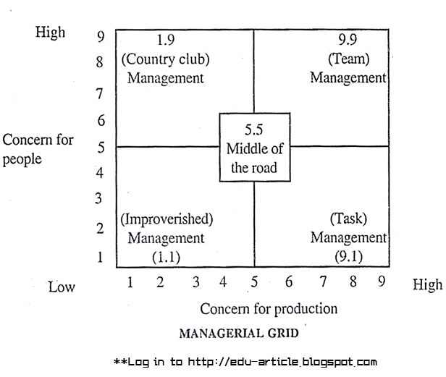

Slide 28
Findings: (five leadership styles)
The 9,1 style: task management/authoritarian
management, primary concern for production
The 1,9 style: Country-club type, primary concern for people
The 1,1 style: Impoverished leadership/laissez-faire management, minimum concern for either prodt^{n} and people
The 5,5 style: Middle-of-the-road/compromising leadership, moderate concern for both production and people
The 9,9 style: Team-based style/democratic management, high concern for both production and people, considered as the most effective leadership style

Slide 29
C. Contingency/Situational Theories of Leadership
(the idea behind it is there is no one finest way of leading and that the style of leadership that is operative in some circumstances may not be effective in others)

Slide 30
Assumptions:
It is the extension of behavioural group of leadership models
There is no one best or right way of successfully leading a group or an organization because a leadership style that is effective in one situation may be ineffective or a total failure in another situation.
A successful leader in a given situation may become a failure in the same position in the same organization when factors around the situation change.
The effectiveness of leadership styles are determined by factors internal and external to the organization, within the leader and employees or followers and the leaders skills and the maturity levels of followers.

Slide 31
Concept:
The internal and external dimensions of the environment require the leader to adapt to that particular situation
Contingency theorists assumed that the leader was the focus of leader-subordinate relationship; situational theorists opined that the subordinates played a pivotal role in defining the relationship.
Theories of situational leadership propose that style of leadership should be accorded with the maturity of the subordinates
(https://www.researchgate.net/publication/293885908)

Slide 32
The situational variables don’t act independently but interact to influence the effectiveness of a leader’s style of behavior. Thus the leadership process is complex, simple prescriptions just are not valid.
Leaders choose the best course of action based upon situational conditions or circumstances. Different styles of leadership may be more appropriate for different types of decision-making.

Slide 33
Fred Fiedler’s Contingency Theory of Leadership
Leader’s effectiveness is dependent on the interaction of the leader’s style and characteristics of the situation variables; leader member-relations, task-structure, and the leader-position power
Leader-member relations: degree of confidence, trust and respect followers have in the leader
Task structure: the extent to which the tasks of subordinates are routine or non-routine
Leader’s position power: the positional/formal power, the degree of influence a leader has over power variables such as hiring, firing, discipline, promotions, and rewards

Slide 34
Situations:
Very Favourable Situation: when all three critical elements are high.
Intermediate Favourableness: a condition when some of the situational characteristics are poor / low and others are good / or high.
Unfavourable Situation: a situation where all three situational components are low or poor.

Slide 35
Leadership Styles:
Task – oriented style and relationship oriented style
These two styles are relatively inflexible and no one style is appropriate for every situation
Both types of leaders can be effective if given the right situation.
The best way to achieve result is to match the manger’s style to a given suitable situation (or train the leader to change the situation to match or fit his own style)

Slide 36
Conclusion (Leadership style and situation match):
a. Task Oriented (TO) leaders tend to be more effective than Relationship Oriented (RO) leaders in two of the three identified situations – in highly favourable and unfavourable situations, and
b. Relationship Oriented (RO) leaders tend to be more effective than TO leaders in situations of intermediate favourableness.

Slide 37
Hersey and Blanchard’s Situational Theory of Leadership
Basic leadership styles
Telling (Directing):
if the follower is new or is characterized by low competence and high commitment,
followers are being unable to comply due to feeling of insecurity,
leader must focus highly on tasks, rather than a relationship with the employee, as a relationship does not yet exist

Slide 38
Selling (Coaching):
the follower who has developed some competence with an improved commitment
the follower is not convinced yet, but is open to becoming cooperative and motivated,
focus is on developing a relationship with the employee and engage followers,
leader must spend more time listening and offering advice, scheduling the follower,
leader should recognize that they have progressed and motivate them to progress even further

Slide 39
Participating (Supporting):
the follower is now competent at the job, but remains somewhat inconsistent and is not yet fully committed,
may be uncooperative or performing as little work as possible, despite their competence with the tasks,
leader no longer needs to give detailed instructions and follow up as often, but does need to continue working with the follower to ensure the work is being done at the level required,
leader must now focus less on the tasks assigned and more on the relationship between the follower, the leader, the team, and the group

Slide 40
Delegating:
follower feels fully empowered, competent enough, highly committed, and motivated,
leader can now delegate tasks to the follower and observe with minimal follow up knowing that acceptable or even excellent results will be achieved,
low focus on tasks and relationships,
a continuous praise for outstanding performance must be given which makes followers feel good and motivated
(http://www.coconutshark.com/coconut-shark-blogs/leadership-telling-selling-participating-delegating)

Slide 41
Advocates that success of leadership style depends upon the maturity of subordinates. Subordinates are those who can accept or reject the leader. “Maturity‟ not in terms of age, emotional stability or physique, but a desire, willingness or readiness and ability to tackle the task facing the group. The maturity levels can be:
M1 = Low readiness level
M2 = Moderate readiness level
M3 = High readiness level, and
M4 = Very high readiness level

Slide 42
Conclusion (Leadership style and maturity level match):
Followers Maturity Level Appropriate Leader Style
M1 = Low readiness level Telling
M2 = Moderate readiness level Selling
M3 = High readiness level Participating
M4 = Very high readiness level Delegating

Slide 43
Path-Goal Theory of Leadership
Assumptions:
Leader complements his/her employees and compensates for their shortcomings
There is one right way of achieving a goal and that the leader can see it and the follower cannot. This casts the leader as the knowing person and the follower as dependent.

Slide 44
Base of the theory:
It is a theory based on specifying a leader's style or behavior that best fits the employee and work environment in order to achieve a goal. The goal is to increase employees' motivation, empowerment, and satisfaction so they become productive members of the org^{n}
It is a process in which leaders select specific behaviors that are best suited to the employees' needs and the working environment so that they may best guide the employees through their path in the obtainment of their daily work activities (goals)

Slide 45
Overcoming obstacles is a special focus of path-goal theory. If an obstacle becomes too strong, then the leader needs to step in and help the employee select a path to work around it
The theory suggests leaders choose a leadership behavior that correlates to the work being done and best fits needs of individual.
As an effective leader, they attend to the needs of subordinates, set goals, determine path (outcome), and help provide support when obstacles arise in reaching goal accomplishment
The theory provides ways for leaders to encourage and support their employees in achieving their goals.
https://www.toolshero.com/leadership/path-goal-theory-leadership/

Slide 46
In particular, leaders:
Clarify the path so subordinates know which way to go.
Remove roadblocks that are stopping them going there.
Increasing the rewards along the route.

Slide 47
Leaders’ behavior or styles:
Directive Style:
Similar to initiating structure concept described by Ohio State Studies and telling style described by Hersey and Blanchard’s studies,
Leader gives psychological support to followers by giving instructions on their task, including what is expected of them, how it is to be done, and the timeline for when it should be completed
Leader sets clear standard of performance and makes the rules and regulations clear to followers

Slide 48
Supportive style:
Similar to consideration concept described by Ohio State Studies
Leader demonstrates friendly behavior, includes attending to the well-being and satisfying individual/human needs
Leader goes out of her/his way to make work pleasant for followers
Leader treats followers as fairly and gives them respect for their status

Slide 49
Participative style:
Similar to consideration concept described by Ohio State Studies
Leader encourages followers to participate in decision making, consults with them, obtains their ideas and opinions, and integrates their suggestions into the decisions about how the group or organization will proceed
The decision is taken by leader him/herself

Slide 50
Achievement-oriented style:
Similar to consideration concept described by Ohio State Studies
Leader challenges followers to perform work at the highest level possible
Leader establishes a high standard of excellence for followers and seeks continuous improvement
Leader shows a high degree of confidence that followers are capable of accomplishing challenging roles

Slide 51
Situational Variables
i. Employee Characteristics: Employees interpret their leader’s behavior based on their needs, such as the degree of structure they need, affiliation, perceived level of ability, and desire for control.
Example: If a leader provides more structure than what they need, they become less motivated and thus the leader needs to understand employees so as to know how to best motivate them.
Employee characteristics are;
Locus of control
Experience
Perceived ability

Slide 52
ii. Task and Environmental Characteristics: Some of the more difficult task characteristics that often arise and the leader should be aware of are:
Design of the task: The design of the task might call for the leader's support. For example, if the task is ambiguous, then the leader might have to give it more structure or an extremely difficult task might call for leader support.
Formal authority system: Depending upon the task authority, the leader can provide clear goals and/or give the employee some or all control.
Work group: If the team is non-supportive, then the leader needs to be cohesive that provides comradeship, enthusiasm, and devotion to all team members.
http://www.nwlink.com/~donclark/leader/lead_path_goal.html

Slide 54
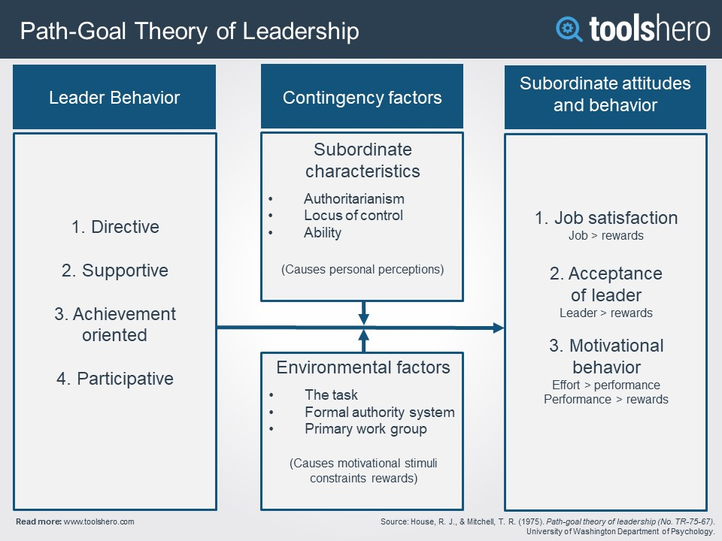

Slide 55
Conclusion
The independent variables of Path-Goal Theory are the leaders' behavior, thus the path–goal theory assumes that people (leaders) are flexible in that they can change their behavior or style, depending upon the situation.

Slide 56
Leaders’ Behavior and Situation Variables
Directive behavior: for individuals that are dogmatic and authoritarian due to ambiguous tasks, it would provide guidance and psychological structure for individuals
Supportive behavior: for an individual completing a job that is unsatisfying or frustrating, it would provide positive effect on individual satisfaction
Participative behavior: for individuals in a frustrating or ambiguous task, by providing participative support would give the individual clarity and path for meeting goals
Achievement-oriented behavior: for individuals in repetitive tasks, by challenging the individual to achieve high standards

Slide 57
D. Autocratic VS Participative Leadership

Slide 58
Propounded by Tannenbaum and Schmidt (1986)
The theory advocates for autocratic and participative concepts of leadership with seven continnum styles

Slide 59
1 Leader makes decision & announces it to followers individually or in a group without discussion (it could also be in writing) | 2 Leader makes decision and sells it to followers by explaining why it is a good idea (it could also be in writing) | 3 Leader presents ideas and invites followers’ questions | 4 Leader presents tentative decision subject to change | 5 Leader presents problem, invites suggested solutions and makes the decision | 6 Leader defines limits and asks the followers to make a decision | 7 Leader permits followers to make ongoing decisions within defined limits
Autocratic Leadership
Participative Leadership
SUGGESTING STYLE
CONSULTING STYLE
DELEGATING STYLE
ABDICATING STYLE
JOINING STYLE
TELLING STYLE
SELLING STYLE

Slide 60
E. Transactional VS Transformational Leadership

Slide 61
Transactional Theory of Leadership
(the idea behind it is managers give employees something they want in exchange for getting something they want)

Slide 62
Assumptions:
Followers perform their best when the chain of command/structure is definite and clear.
Rewards and punishments motivate workers.
Obeying the instructions and commands of the leader is the primary goal of the followers.
Subordinates need to be carefully monitored to ensure that expectations are met.
Followers are not self-motivated and require structure, instruction and monitoring in order to complete tasks correctly and on time

Slide 63
Concept:
Also called managerial theory/telling style of leadership,
Concerned with normal flow of operation
Strict boundaries; tries to ensure effectiveness and efficiency
It focuses on the role of supervision, results, conforms to the existing structure of an organization and measures success according to that organization’s system of rewards and penalties.
Leader is responsible for maintaining routine by managing individual performance (focus on leader’s need)
Useful when there is strict deadline, constrained resource, need to maintain group dynamism, emergency/urgency, project needs to be carried out in a specific way
Leader views the relationship followers as an exchange – you give me something for something in return. When followers perform well, they receive a reward. When they perform poorly, they will be punished in some way.

Slide 64
Transformational Theory of Leadership
(the idea behind it is leaders hold positive expectations for followers, believe that they can do their best)

Slide 65
Assumptions:
People will follow a person who inspires them.
A person with vision and passion can achieve great things.
The way to get things done is by injecting enthusiasm and energy.

Slide 66
Concept:
Also called relationship theory
It is about to go beyond day-to-day operations
It is a process that changes and transforms people
It is concerned with emotion and values of followers, engaging them, satisfaction of their need and treating them humanly, motivating by reward and support (focus on need of others)
Leader leads followers by inspirations, examples, vision & values to achieve results greater then originally planned (remarkable)
Leader provides opportunities of personal and professional growth to each follower
Focus is on making tomorrow better
Leader sees before and more than others
Leader sees followers differently than others (sees things that others don’t see)

Slide 67
Components of Transformational Leadership
Idealized Influence: leader does not just say do this and that rather her/himself does the right thing (a positive role model)
Inspirational Motivation: ability of a leader is to inspire followers to move them to action, to create a corporate vision aligned with individuals
Individualized Consideration: ability of a leader to connect with each follower to be in tune to know and understand followers’ strength, their needs and the ability to satisfy their personal needs
Intellectual Stimulation: involves challenging followers to be creative and innovative and to think differently
(Note: Components a and b are related with charisma of leaders and c and d are charisma plus components)

Slide 68
Ways of transformation
Transformation occurs in two ways:
Transforming collectively for performance: transforming the group during the time of change or inspiring/moving them to high level of performance
Transforming followers into leaders: it is all about developing followers’ leadership capacity

Slide 69
Sales
Transformational Leadership
Leader (Kanchan): Gita, Great work. Your performance was remarkable.
Follower (Gita): Thanks Kanchan.
Transactional Leadership
Leader (Kanchan): Sales picked up this week. Great work Gita.
Follower (Gita): Thanks Mam.

Slide 70
Transactional leadership | Transformational Leadership
Leadership is responsive | Leadership is proactive
Works within the organizational culture | Work to change the organizational culture by implementing new ideas
Transactional leaders make employees achieve organizational objectives through rewards and punishment | Transformational leaders motivate and empower employees to achieve company’s objectives by appealing to higher ideals and moral values
Motivates followers by appealing to their own self-interest | Motivates followers by encouraging them to transcend their own interests for those of the group or unit
https://managementstudyguide.com/transactional-leadership.htm

